Slide 1
Effects of Single and Repeated Social Defeat Stress on DA Neurons in the mPFC
Brock Baade

Slide 2
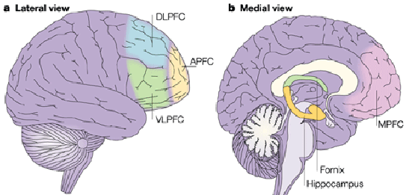
Medial prefrontal cortex
Social Cognition¹
Executive Functions²
Altered activity in psychiatric disorders
Depression³
Anxiety⁴
Bi-polar disorder⁵
Dorsal & Ventral
Notes:
-Exec Fxns→working memory, cognitive flexibility (adaptive thinking), inhibitory control
http://www.nature.com/nrn/journal/v4/n8/fig_tab/nrn1178_F1.html
Prefrontal and medial temporal lobe interactions in long-term memory
Jon S. Simons & Hugo J. Spiers
Ventral more with reward-seeking/motivation
Dorsal perspective and memory retrieval

Slide 3
Why does this matter?
Stress on the mPFC⁶
Dendritic Atrophy
Correlated to behavioral changes
Role of each DA-R subtype in response not understood
Offers novel targets for drug therapy
Notes:
Picture: Microscopy of rat layer V pyramidal neuron in mPFC following chronic restraint stress (30min/7days)
-dendrite atrophy known to happen after R-SDS
-atrophy is related to decrease excitatory curr
https://www.ncbi.nlm.nih.gov/pmc/articles/PMC2224217/
Rong-Jian Liu* and George K. Aghajanian

Slide 4
Mesocortical Pathway
Notes:
-Dopaminergic
Rodent brain
The Brain Reward Circuitry in Mood Disorders
Scott J. Russo and Eric J. Nestler
Fishberg Department of Neuroscience
schematic of the major dopaminergic, glutamatergic and GABAergic
connections to and from the ventral tegmental area (VTA) and nucleus accumbens (NAc)
(dopaminergic=green; glutamatergic=red; and GABAergic=blue)

Slide 5
Questions
1. By what mechanism is the mesocortical pathway regulated through R-SDS?
2. What are the differences in response from D1/D2 subtype receptors in mPFC to S-SDS & R-SDS?
3. What are the effects of early life stress on D1/D2 subtype receptors in mPFC?

Slide 6
Tanaka et al., 2012

Slide 7
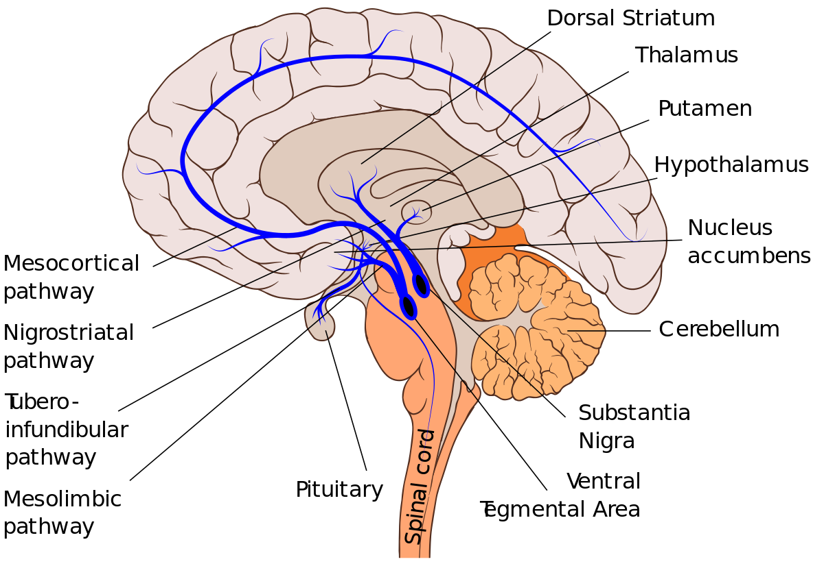
Dopamine Receptors⁷
G-coupled receptor
2 Major Groups
D1-like (D1,5)
D2-like (D2,3,4)
Location of receptors
D1-postsynaptic
D2-pre & postsynaptic
Notes:
-Major difference is D1 activates Gs and stimulates AC & D2 activates Gi and inhibits AC
https://www.ncbi.nlm.nih.gov/pubmed/21303898

Slide 8
Prostaglandin e2 (pge2)⁸
Bioactive Lipid
Functions
Involved in labor
NSAID’s/COX & Depression
Binds to g-coupled receptors
EP1,2,3, & 4
Notes:
-aka: dinoprostone
-found in medications (induce labor, terminate pregnancy)
-made from arachidonic acid
-Clinical trial found NSAID that inhibited COX also had therapeutic effects on major depression→https://www.ncbi.nlm.nih.gov/pubmed/19496103

Slide 9
Methods
C57BL/6 at postnatal day (PD) 35
EP1,2,3,4-deficient
Housed in groups of 4
Isolated prior to R-SDS
Social Defeat
ICR aggressor
Resident-Intruder 10min/10 days
Notes:
-C57BL6 mice used at 6-weeks old (isolated 1 week prior to defeat)
-Conditional KO of EP4 since is deadly
-CD1 were screened and picked for aggression
-SDS: C6 mouse put in empty cage for 150s day prior to SDS
-COX-1,2 deficient mice were purchased

Slide 10
Methods
Social Interaction Test
1st trial empty
150s
Elevated Plus Maze
Acclimated
10 min
Notes:
-SI test (open field chamber w/ intrxn zones) for 150s
-Done at 6h before first SD; 18h after 1st,4th, & 10th defeat
-other experiments done on Day 11
-(+) maze done for 10min on Day 11 of R-SDS
***drugs given were before/after every SDS & SI test***

Slide 11
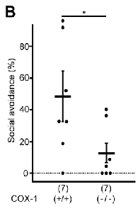
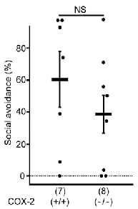
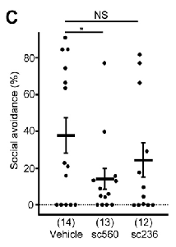
Figure 2. COX-1-mediated PGE2 synthesis is critical for induction of social avoidance by repeated social defeat.
Notes:
[PGE2] on control/defeated mice (higher in defeated)
-shows PGE2 involved in SA
SA level after R-SDS in COX-1,2 def mice vs. heterozyg wild-type litter mates
-means COX-1 mediates PGE2-related SA compared to COX-2
SA level after COX-1 antag (560) & COX-2 antag (236)
-further evidence for COX-1 and SA

Slide 12
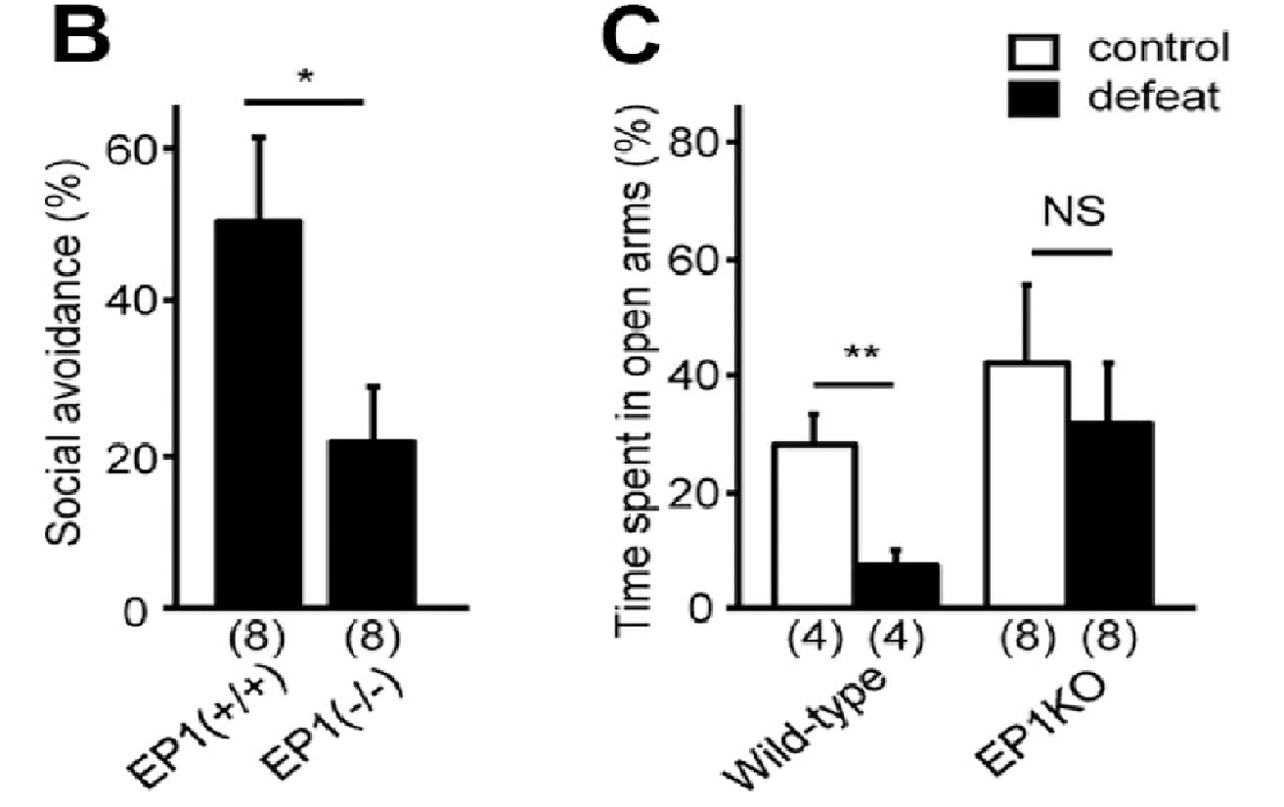
Figure 4. EP1 is critical for induction of social avoidance and elevated anxiety by repeated social defeat.
Notes:
EP1-KO mice lower SA
-suggests EP1-PGE2 has role in induction of SA
B. EP1-deficient mice lower SA than EP1-heterozyg wild-type littermates
-suggests same as A
C. ????????????????????? Suggests EP1 has anxyiogenic effects

Slide 13
Figure 5. EP1 is not critical for induction of submissive posture and glucocorticoid response by repeated social defeat.
Notes:
Submissive posture time of EP1-KO & WT; similar increase after r-sds
-suggests EP1-PGE2 mechanism not required for perception of stress
B. Similar corticosterone levels after r-sds in EP1-KO & WT
*levels taken after D1 & D10 of r-sds**

Slide 14
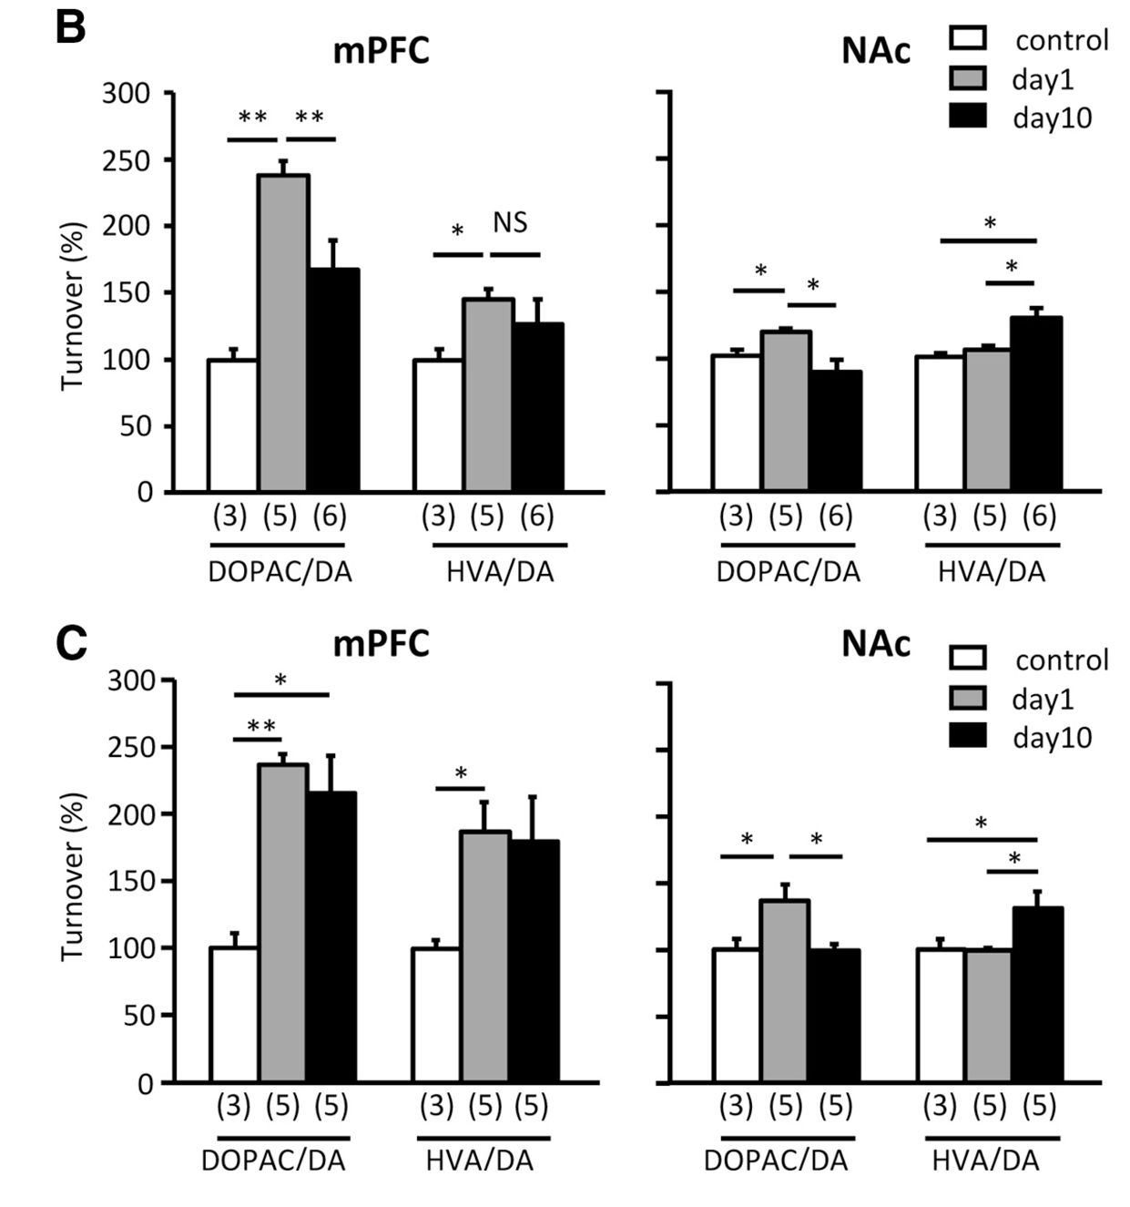
Figure 7. EP1-dependent attenuation of mPFC dopaminergic response by repeated social defeat.
Notes:
Circular regions in mPFC used for dopamine turnover measurements
Ratio of DA metabolites in mPFC/Nac of WT after r-sds
Same as B but for EP1-deficient mice
**DA turnover not attenuated by EP1-def-> WT had lower DA on D10

Slide 15
Figure 8. Elevated dopaminergic activity due to EP1 deficiency underlies the lack of social avoidance by repeated social defeat.
Notes:
-SCH23390 (D1-like receptor antag) restored SA in EP1-KO mice
-Suggests that disinhibited dopaminergic response (due to EP1-def. & lack of attenuation) to stress interferes with induction of SA
-Drug did NOT affect WT SA%
-Suggests D1-R already attenuated following R-SDS**
*given before ever SDS but not before SI test*

Slide 16
Figure 9. mPFC dopaminergic response counteracts induction of social avoidance by social defeat.
Notes:
(-) correlation between mPFC DA turnover and SA% following R-SDS
-suggests relationship between DA turnover attenuation & social avoidance
-*****important for possible therapy
-each dot is a mouse on Day 11
-R-SDS→SI test Day 10-→additional SDS day 11→killed for DA turnover

Slide 17
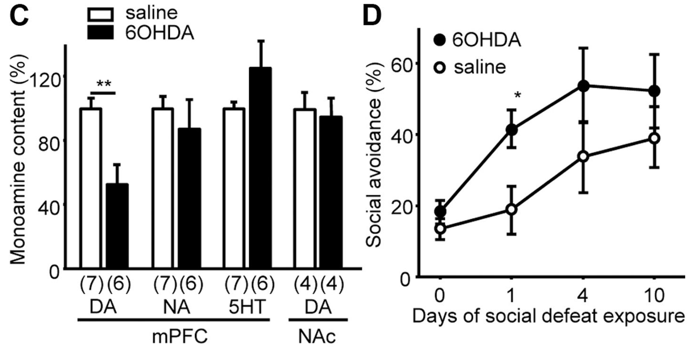
Figure 9. mPFC dopaminergic response counteracts induction of social avoidance by social defeat
Notes:
B. Injection site for 6OHDA (infralimbic to prelimbic cortex) to deplete mPFC [DA]
C. Measurements of DA 7-10 after surgery in mPFC & Nac
-shows depletion worked
D. SA% in lesion mice following 1st,4th, & 10th SDS
-Depleted DA turnover correlated w/ induction of SA
-Suggests mPFC DAnergic response upon SDS counteracts induction of SA & EP1-mediated attenuation of this DA response induces SA

Slide 18
Recap
Notes:
-Done using COX-1
-PGE2-EP1 attenuates DA response from mPFC in R-SDS
-in S-SDS mPFC DA neurons suppress induction of SA

Slide 19
Questions
1. By what mechanism is the mesocortical pathway regulated through R-SDS?
2. What are the differences in response from D1/D2 subtype receptors in mPFC to S-SDS & R-SDS?
3. What are the effects of early life stress on D1/D2 subtype receptors in mPFC?

Slide 20
Shinohara et al., 2017

Slide 21
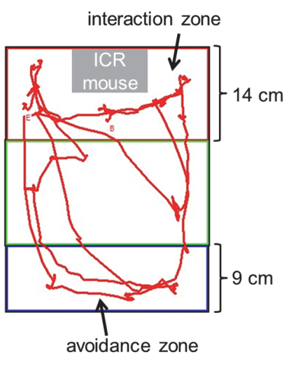
Methods
C57BL/6, 13-14 weeks old
Injected at week 8
D1-KD
Social Defeat
10 minute sessions for 10 days
Social Interaction Test
150s
Notes:
-C6 aggressive mouse used in res-intruder SDS
-SI Test: 18h after 1st SDS & 10th SDS
-2nd SDS done 2h after first SI test
-Open field chamber with novel ICR mouse in metal meshwork
-time spend in avoidance & social interaction zones recorded
-SA susceptibility: increase in time in avoidance & decrease in social zone
-susceptible & resilient mice
-AAV viruses used to express D1-R with some GFP/mCherry molecule in presense of Cre Recombinase

Slide 22
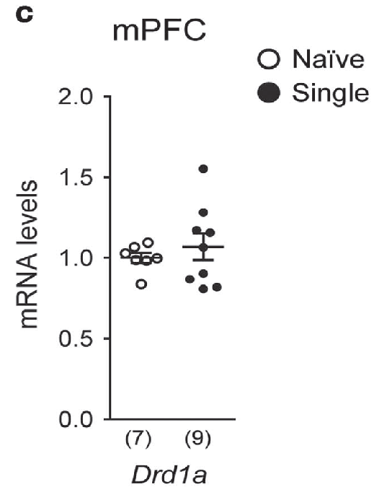
Figure 1. Dopamine D1 receptor subtype in medial prefrontal cortex (mPFC) neurons contributes to suppression of repeated social defeat stress-(R-SDS) induced social avoidance.
Notes:
A. Shows R-SDS reduced D1-like (D1,5) R expression in susceptible mice, less so in resilient
-D2 unchanged in susceptible relatively but higher expression in resilient??
-D2,4, (D2-like) relatively unchanged
C. Shows no change in D1 mRNA levels after S-SDS
*Put in B???*

Slide 23
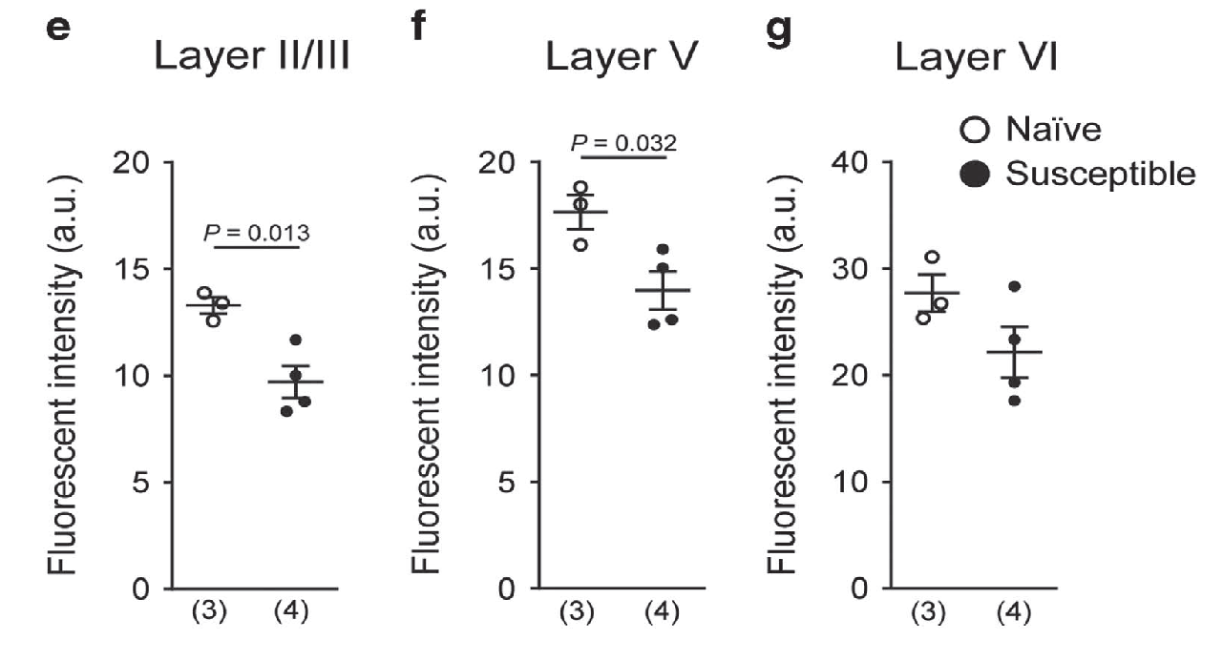
Figure 1. Dopamine D1 receptor subtype in medial prefrontal cortex (mPFC) neurons contributes to suppression of repeated social defeat stress-(R-SDS) induced social avoidance.
Notes:
D. ImmunoF staining for D1-R & NeuN (neuronal marker) in naive/suscept mice
-shows decrease in D1 expression in layer II/III of susceptible mice
E. Quantification of immunstaining
-Layer II/III & V lower in susceptible mice

Slide 24
Figure 1. Dopamine D1 receptor subtype in medial prefrontal cortex (mPFC) neurons contributes to suppression of repeated social defeat stress-(R-SDS) induced social avoidance.
Notes:
I.-Effect of D1-KD w/o prior stress
-suggests not involved until prior stress
J. Effect of D1-KD on induction of SA following S-SDS & R-SDS
-D1-KD showed induction of SA after S-SDS compared to control
-suggests D1 involved in suppression of induction of SA by S-SDS

Slide 25
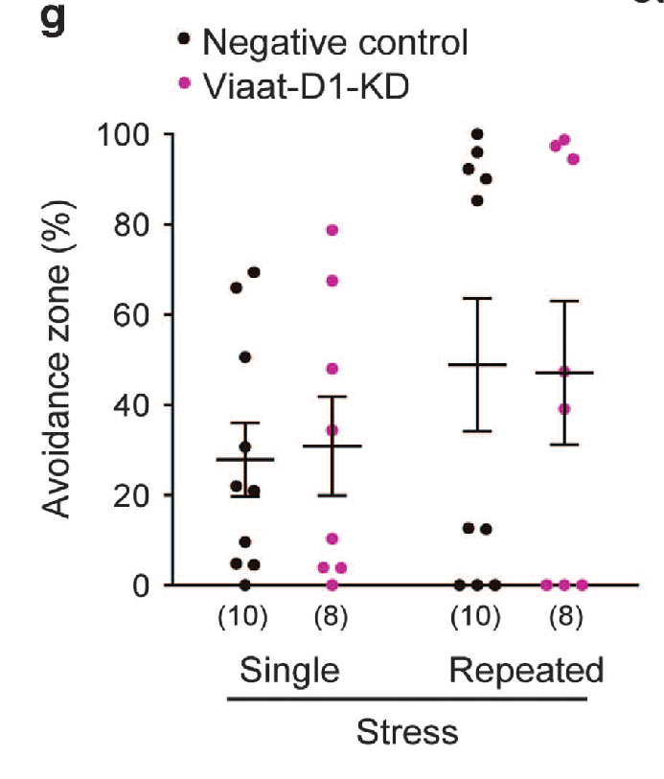
Figure 2. Medial prefrontal cortex (mPFC) excitatory neurons are the site of action of D1 receptor subtype for contributing to suppression of repeated social defeat stress (R-SDS)-induced social avoidance
Notes:
C. KD of D1-excitatory neurons (through CamKII) facilitated induction of SA after S-SDS
-Viaat is restricted to GABA positive neurons (inhibitory)
**Not seen in R-SDS→Blame tamoxifen as delay of SA induction
G. KD of D1-inhibitory neurons (through Viaat) did not change SA following SDS
-suggests suppression of induction of SA is regulated by D1-excitatory neurons

Slide 26
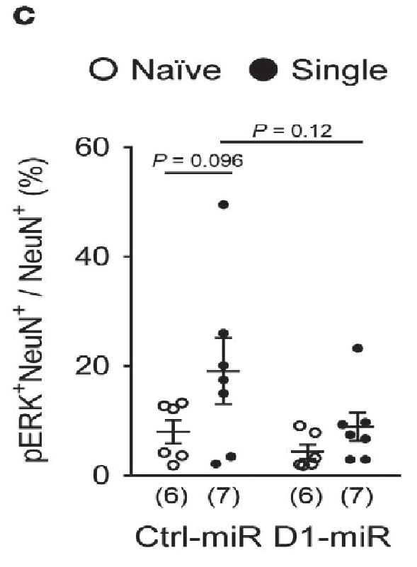
Figure 3. Single social defeat stress (S-SDS) induces extracellular signal-regulated kinase (ERK) phosphorylation and c-Fos expression in medial prefrontal cortex (mPFC) neurons through D1 receptor subtype.
Notes:
Immunostaining of pERK in mPFC w/ SDS
-SDS increased pERK in control mice
-increase in pERK following SDS not seen in D1-KD
-→suggests pERK is D1-dependent following S-SDS

Slide 27
Figure 3. Single social defeat stress (S-SDS) induces extracellular signal-regulated kinase (ERK) phosphorylation and c-Fos expression in medial prefrontal cortex (mPFC) neurons through D1 receptor subtype.
Notes:
E. Densities of pERk in Excit & inh. neurons of mPFC
-SDS increased pERK in excit but not in inhibitory neurons
F. Densities of pERK excit. neurons after SDS
-Increase in pERK following SDS attenuated in D1-KD mice
-suggests S-SDS induces p-ERK atleast partly through D1-receptor subtype

Slide 28
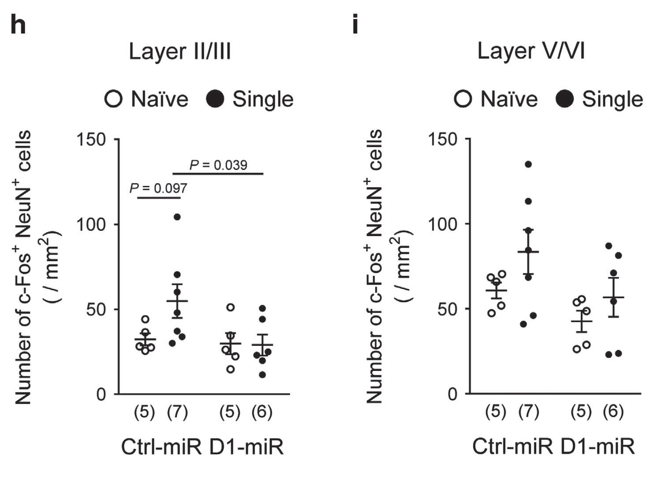
Figure 3. Single social defeat stress (S-SDS) induces extracellular signal-regulated kinase (ERK) phosphorylation and c-Fos expression in medial prefrontal cortex (mPFC) neurons through D1 receptor subtype.
Notes:
G. Immuno staining of c-fos in mice following SDS w/ D1-KD mice
H/I.-densities of c-fos neurons in mPFC in different neuron layers of D1-KD mice
-Less layer II/III increase in firing in D1-KD mice following SDS
-suggests layer II/III excitatory neurons are mediated by D1-like receptors
-no change in other layers

Slide 29
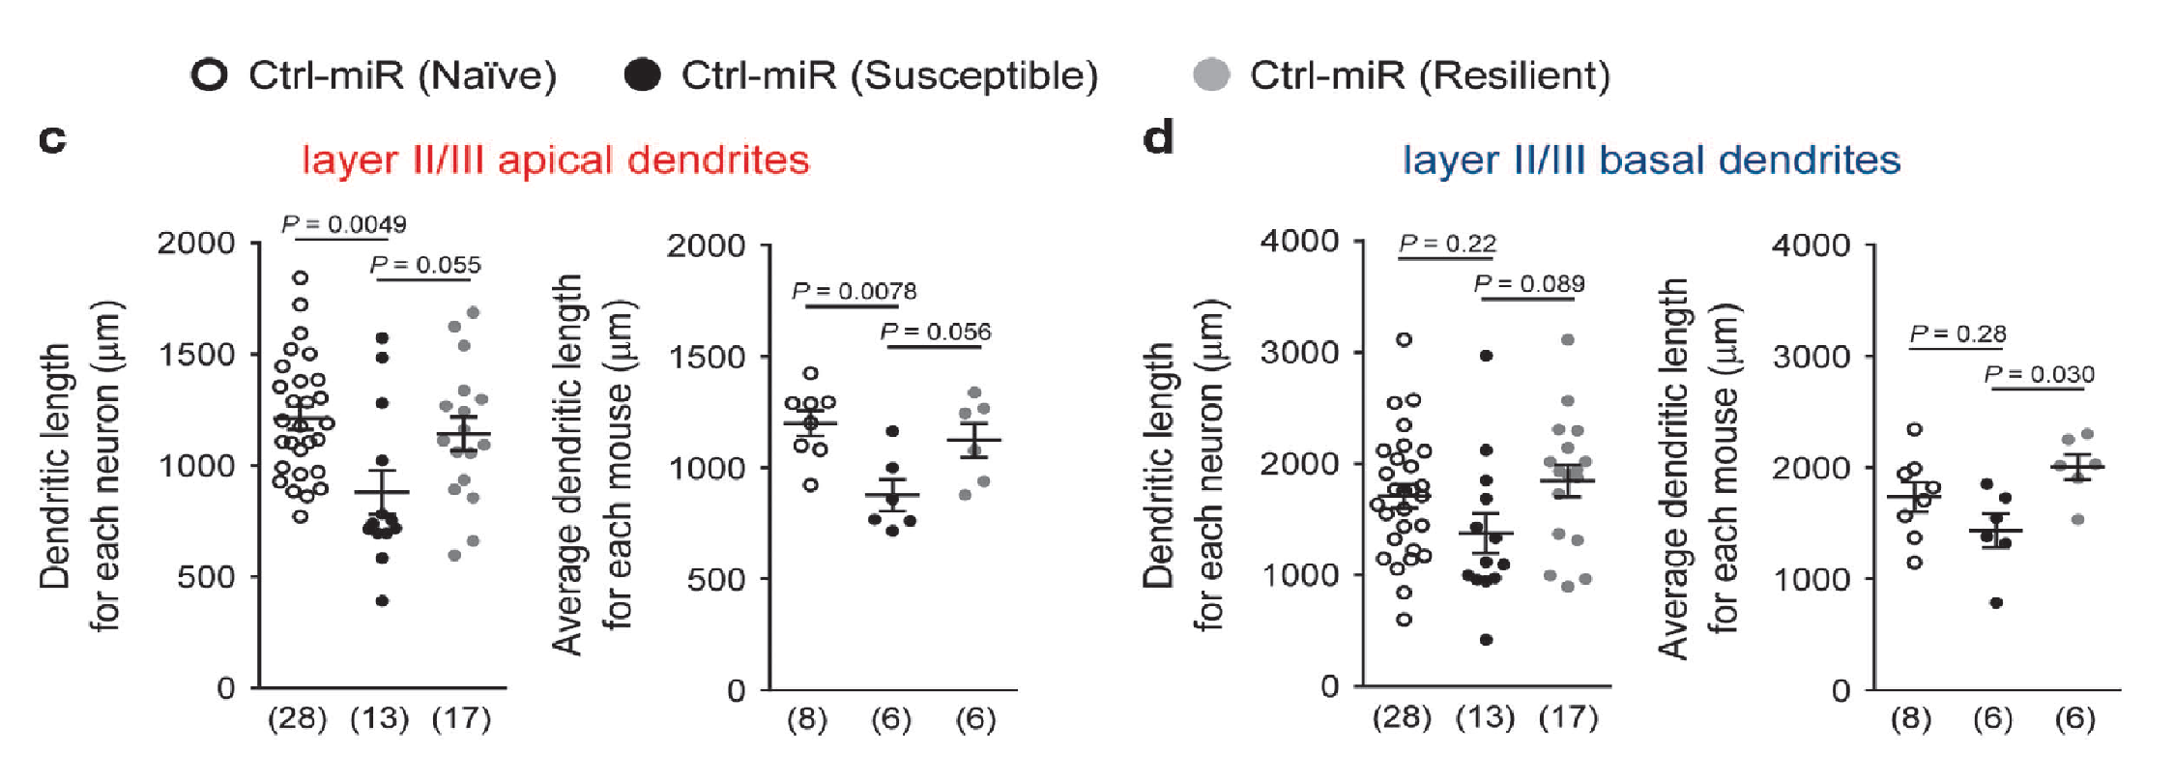
R-SDS
Figure 4. Single social defeat stress (S-SDS) induces dendritic growth selectively in apical dendrites of medial prefrontal cortex (mPFC) layer II/ III pyramidal neurons through D1 receptor subtype.
Notes:
b. 3d reconstruction of II/III neurons in mPFC after R-SDS (Apical:red Basal:blue)
-branching less in susceptible mice; more in resilient?
C/D. effects of R-SDS on the lengths of apical/basal dendrites in mPFC
-R-SDS decreased apical dendrite length but not branching points or spine density of pyramidal neurons
-seen in susceptible group but not resilient
**suggests R-SDS induced shortening is correlated w/ stress susceptibility**

Slide 30
Supplementary Figure 13. R-SDS did not potentiate dendritic shortening in D1-KD mice.
Notes:
-Shortening of dendrites was not potentiated by D1-KD
**suggests other mechanism for dendritic shortening**

Slide 31
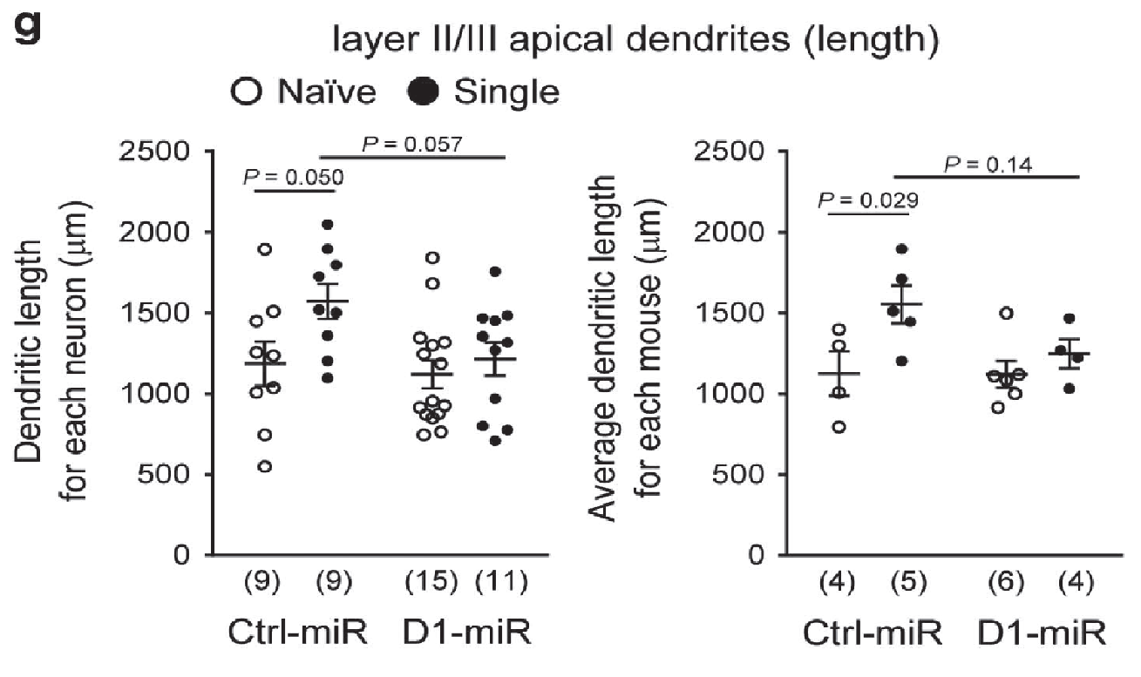
Figure 4. S-SDS induces dendritic growth selectively in apical dendrites of mpfc layer II/III pyramidal neurons through D1 receptor.
S-SDS
Notes:
F. 3d model of pyramidal neurons in mPFC D1-KD mice following S-SDS
G. Analysis of dendrite length & branching points following S-SDS
-S-SDS increased dendrite length & branching points
-D1-KD mice did not see increase following S-SDS

Slide 32
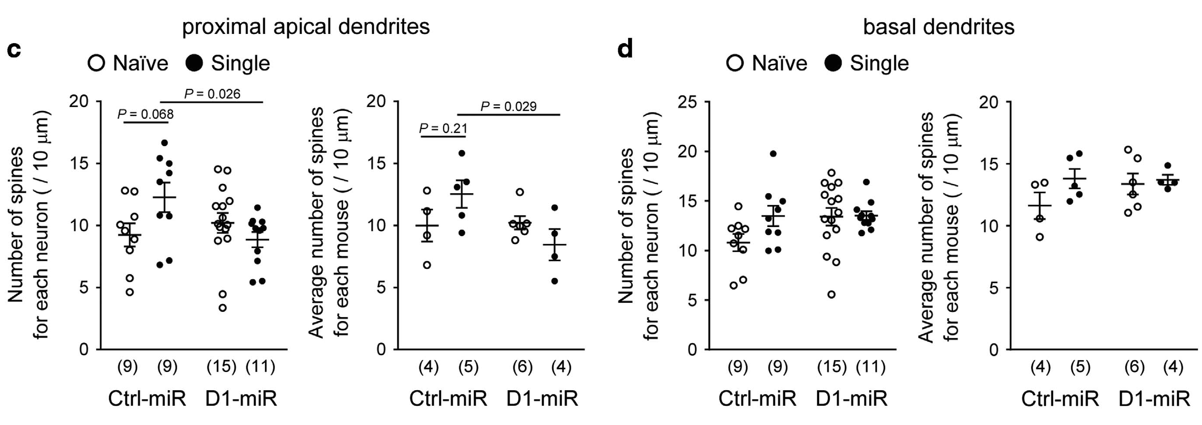
Figure 5. Single social defeat stress (S-SDS) increases spine density selectively on apical dendrites of medial prefrontal cortex (mPFC) layer II/III pyramidal neurons through D1 receptor subtype.
Notes:
Image of distal apical dendrite spines on pyr. Neurons of mPFC II/III layer after SDS
B.-effects of S-SDS on spine density on distal apical dendrites of mPFC II/III neurons
-S-SDS increased density of dend. Spites on distal & proximal apical dendrites

Slide 33
Figure 5. Single social defeat stress (S-SDS) increases spine density selectively on apical dendrites of medial prefrontal cortex (mPFC) layer II/III pyramidal neurons through D1 receptor subtype.
Notes:
-Type 1: spines with head/neck diameter ratio >1.7
-Type 2: spines with head/neck diameter ratio < 1.7
E/F.- Type 1 & 2 spines on apical dendrites following S-SDS in D1-KD mice
-shows S-SDS increased number of type 2 spines but not type 1
-increase was not seen in D1-KD
-suggests increase in type II may be done in a D1-dependent manner?

Slide 34
Recap
D1 subtype affected most by SDS
D2 higher in resilient mice
D1 subtype receptors contribute to suppression of social avoidance induced by R-SDS
S-SDS induces selective dendritic growth in a D1-dependent manner
Induces p-ERK in excitatory neurons
Apical dendrites, Type II spines
Notes:
-D2rda was higher in resilient mice, only significant thing outside d1-like

Slide 35
Questions
1. By what mechanism is the mesocortical pathway regulated through R-SDS?
2. What are the differences in response from D1/D2 subtype receptors in mPFC to S-SDS & R-SDS?
3. What are the effects of early life stress on D1/D2 subtype receptors in mPFC?

Slide 36
Watt et al., 2014

Slide 37
Methods
Sprague-Dawley rats, n=190
Social Defeat Stress (P35 or P70)
Resident-Intruder 10 min/5 days
Separated by wire barrier for 25 min
Analysis
17 days after (P56 or P91)
Notes:
-Housed in pairs
-Resident rats (pre screened) were allowed in cage for 3 weeks to increase territoriality
-Adolescent rats screened on P35(to 39), adults P70
Social Defeat: -after 3 consecutive submissive postures mouse is defeated
-intruder/resident separated by wire mesh for 25min
-intruders different every time to vary intensity
-Surgeries done on P28

Slide 38
Results
Figure 1. DA activity (as a ratio of DOPAC/DA) in the mPFC of rats defeated in adolescence (P35– 39) or adulthood (P70–74), as sampled 17 days following the last defeat episode (at P56 or P91).
Notes:
-R-SDS on (P35-P39) shows a significant difference in DA turnover in adolescence
-adolescence showed decreased DA turnover 17 days after R-SDS
-adults had an increased mPFC **linked to ARTICLE 2?*
*: P<0.05
#:P<0.05
&:P<0.05
10 per group

Slide 39
Figure 3. Dopamine activity (as a ratio of DOPAC/DA) in the mPFC of rats defeated in adolescence (P35-39), sampled at P40, P49 or P56.
Notes:
-Effects of R-SDS on adolescent mice (P35-39)
-Defeated Mice: Increased DA at P40 and P49 compared to control….but reduced at P56
-Control: Increase at P49 then leveled off
-Suggests dopamine turnonver is altered during adolescent stress

Slide 40
Figure 4. Effects of D2-agonist on DA turnover in adolescence and adulthood.
Notes:
-D2-R agonist (quinpirole) during adolescence (P35-39)
-would activating D2 mimic social defeat in adolescence by decreasing [DA} in adulthood?
Ventral limbic & infralimbic subregions injected with agonist
Effects of agonist in adolescence and DA turnover
-no change in adolescence from drug
-DA turnover less in drugged mice
-***suggests D2 hyperexpression in adolescence causes DA decrease in adulthood

Slide 41
Figure 5. Effects of D2-antagonist on DA turnover at P56 following ELS.
Notes:
Location of injection of D2-R antag amisulpride in adolescent mice
-injected everyday prior to SDS (P35-39)
-Brain slices taken on P56
-adolescent control rats saw decrease DA turnover in adults if w/ ELS
-Antag attenuated this decrease in DA turnover caused by R-SDS
-**goes with prev. slide suggesting D2 expression and DA decrease in adulthood

Slide 42
Figure 6. Hypothesized progression of events by which adolescent defeat results in adult mPFC DA hypofunction.
Notes:
-Sustained mPFC DA release during repeated adolescent defeat results in prolonged over-activatrion of presynaptic D2 autoR that causes long-term reductions in mPFC activity
-suggests mechanism by which D2-like receptor is inhibited long term
-D2 autoR become hyper sensitive to DA (due to prolonged stress exposure/response during adolescence) and continuously inhibit DA release
-Also hypothesize increase in DAT resulting in less EC DA

Slide 43
Notes:
https://www.ncbi.nlm.nih.gov/pubmed/24463000
Ford, CP 2014
-D2 autoR become hyper sensitive to DA and continuously inhibit DA release
-inhibits TH conversion continuously

Slide 44
Conclusion
PGE2-EP1 attenuates the mesocortical response to social defeat and is critical for the induction of social avoidance via R-SDS
S-SDS induces dendritic growth in layer II/III pyramidal neurons of mPFC in a D1-dependent manner and contributes to the suppression of stress susceptibility
Early life R-SDS causes hypersensitivity of D2-like neurons, contributing to long-term reductions in adult mPFC DA activity
Notes:
-D1-KD does not potentiate R-SDS induced dendritic shortening

Slide 45
References
Bzdok, D., et al. (2014). “Segregation of the human medial prefrontal cortex in social cognition” Human Neuroscience.
Robbins, T.W., et al. (2009). “The neuropsychopharmacology of fronto-executive function: monoaminergic modulation.” Annu Rev Neurosci. 32:267–87.
Drevet, W.C., et al. (2009) “Brain structural and functional abnormalities in mood disorders: implications for neurocircuitry models of depression.” Brain Struct Funct. 213:93–118.
Heidbreeder, C.A., (2003). “The medial prefrontal lcortex in the rat: evidence for a dorso-ventral distinction based upon functional and anatomical characteristics.” Neurosci Biobehav Rev, 27, 555–579.
Anticevic, A., et al. (2013).” Global Prefrontal and Fronto-amygdala Dysconnectivity in Bipolar I Disorder with Psychosis History.” Biological Psychiatry, 73(6), 565–573.
Tanaka, K., et al. (2012). “E2-mediated attenuation of mesocortical dopaminergic pathway is critical for susceptibility to repeated social defeat stress in mice”. J Neurosci 32: 4319–4329.
Beaulieu, J.M., (2011). “The physiology, signaling, and pharmacology of dopamine receptors”. Pharmacol Rev. 63(1):182-217
Akhondzadeh S., (2009). “Clinical trial of adjunctive celecoxib treatment in patients with major depression: a double blind and placebo controlled trial”. Depress Anxiety. 26:607– 611.
Shinohara, R. (2017). “Dopamine D1 receptor subtype mediates acute stress-induced dendritic growth in excitatory neurons of the medial prefrontal cortex and contributes to suppression of stress susceptibility in mice.” Mol. Psychiatry, (00) 1-14.
Watt, M.J., (2014). “Decreased prefrontal cortex dopamine activity following adolescent social defeat in male rats: role of dopamine D2 receptors.” PsychPharm. (8):1627-1636.

